Slide 1
Project title: Let’s remove bullying and promote kindness to one another
Project number:2020-1-UK01-KA229- 078813_4,
Erasmus+ 17-22 of May 2022
LUIS CARRILLO DE SOTOMAYOR HIGH
SCHOOL Baena spain

Slide 2
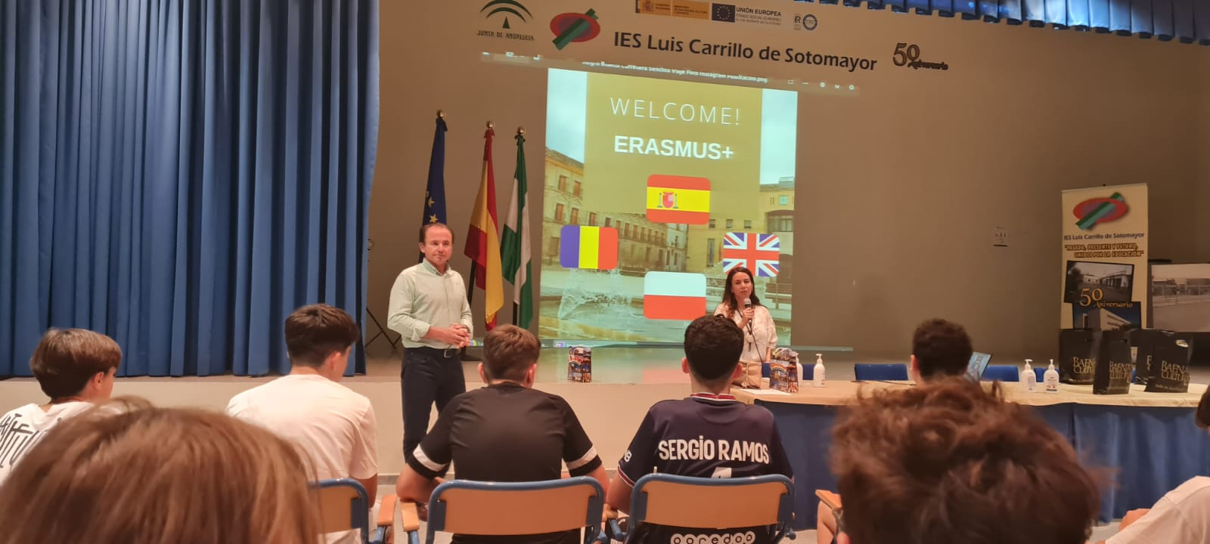
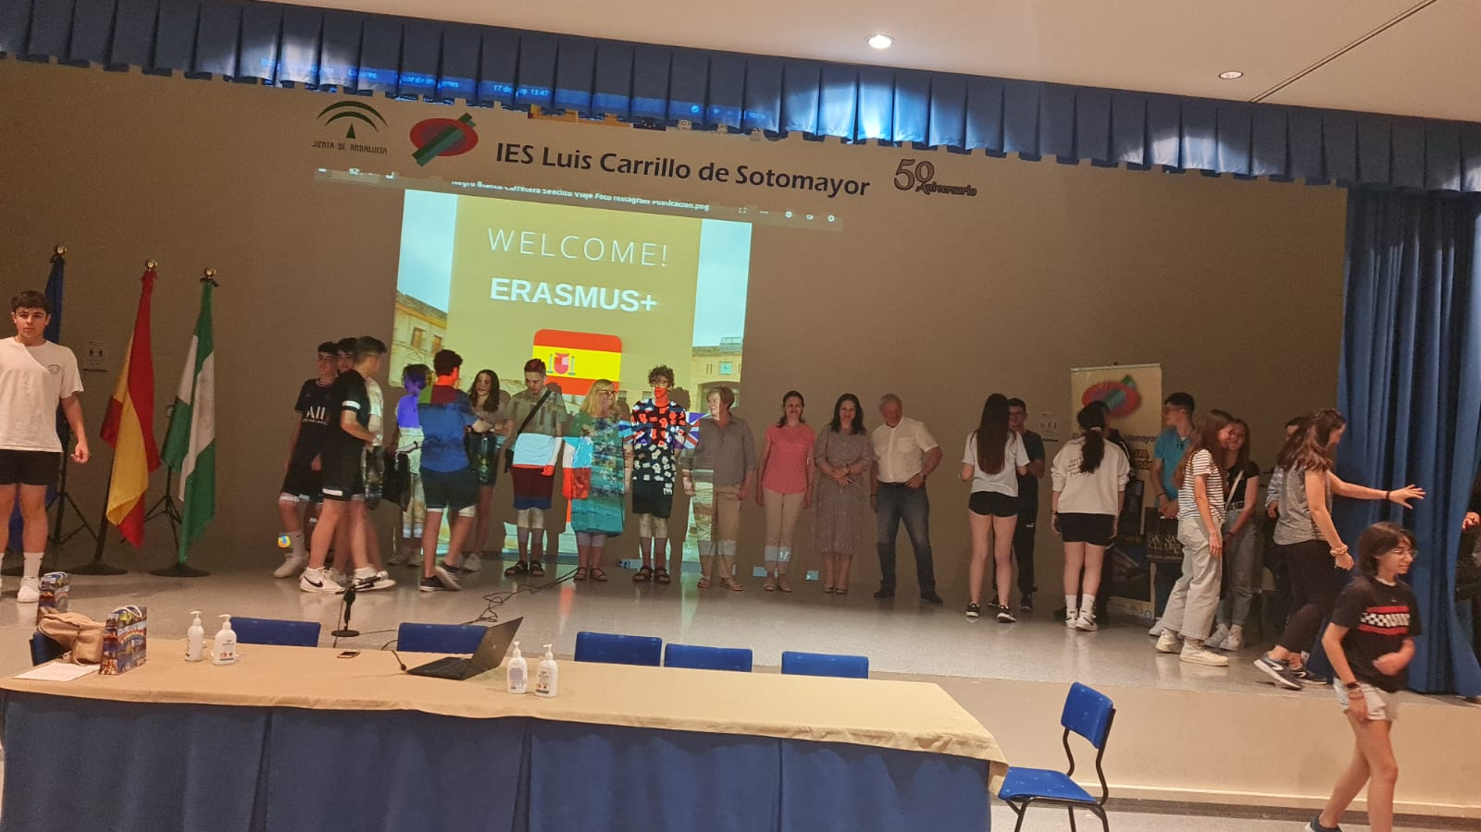
During the period 17-22.05.2022, students and teachers from Spain, Romania and Poland participated in the meeting entitled “How do I know when I am being bullied? - Identification of cyber-bullying incidents ”, which took place at LUIS CARRILLO DE SOTOMAYOR HIGH SCHOOL in Baena, Spain.
During the five days, students participated in various school and extracurricular activities, which consisted of workshops, interviews, case studies, sports games, meetings with parents, a solidarity fair to help children in Ukraine and children with cancer, visiting cultural institutions and objectives.

Slide 3
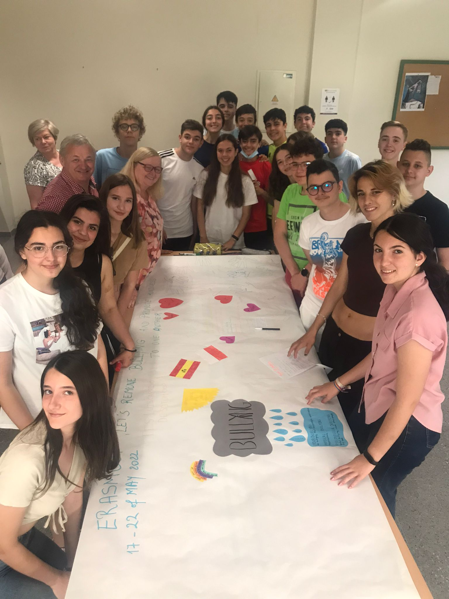
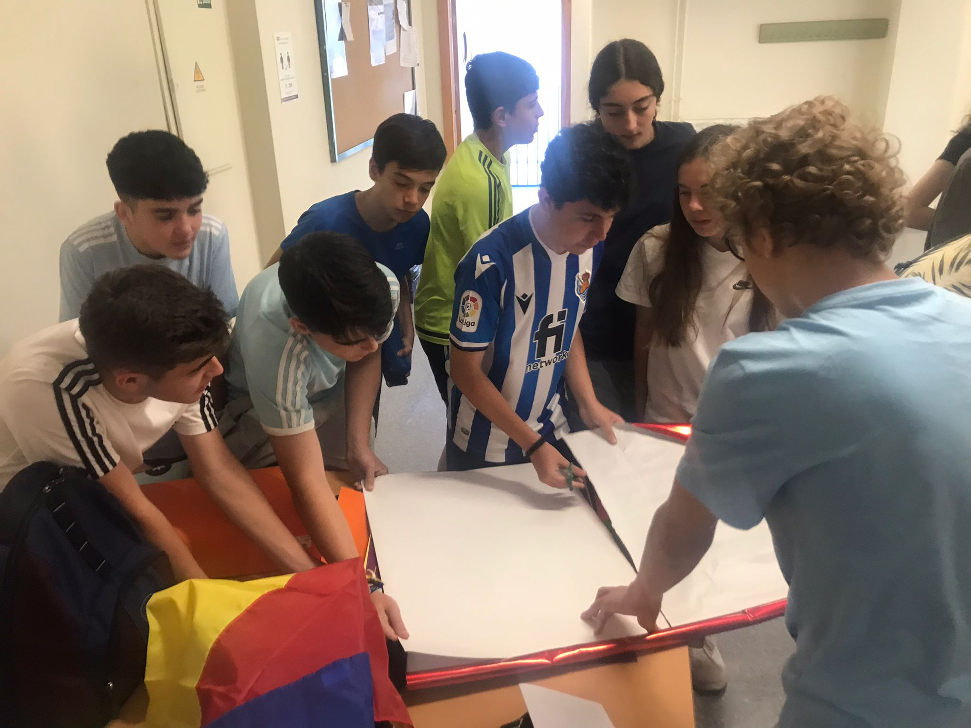
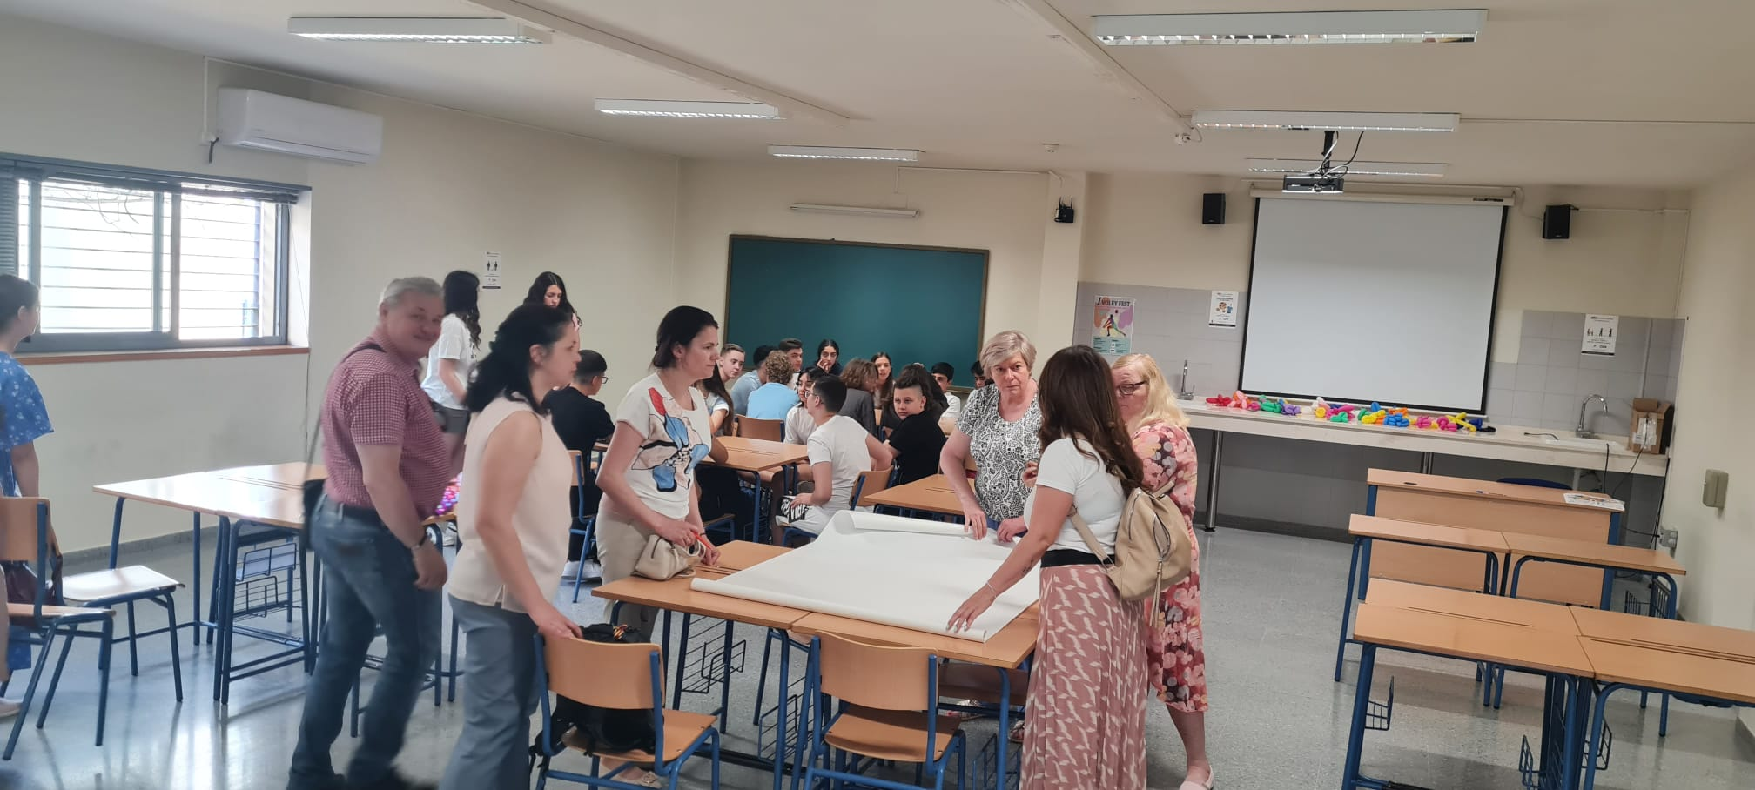
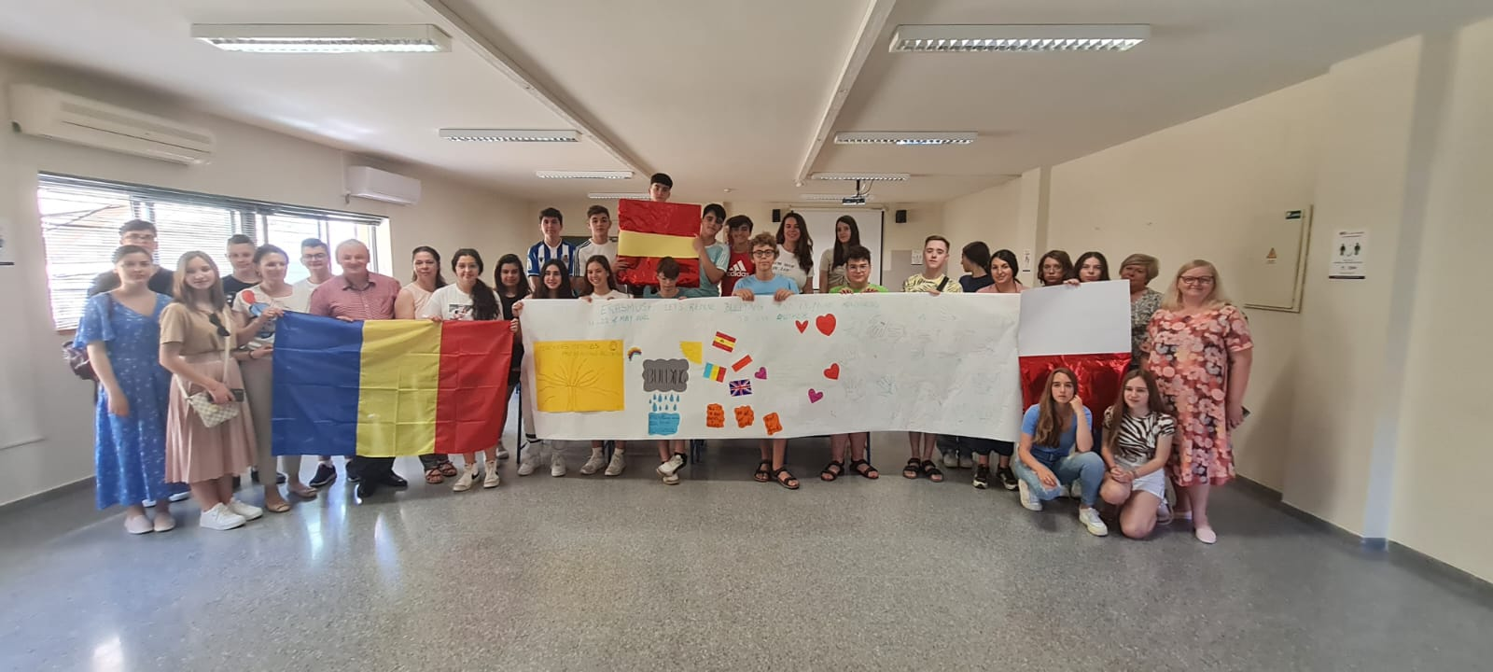
During the school activities, students had the opportunity to interact, to communicate in English, to share their experience, to develop their personal skills to identify known and less known forms of bullying and its effects, but also for to find solutions on how to act and prevent this phenomenon.
The final products, made by the students, highlighted their creativity, solidarity, enthusiasm and involvement. Teachers from the three participating countries supported the students during the activities and consulted on the methods used to identify cyberbullying situations.

Slide 4
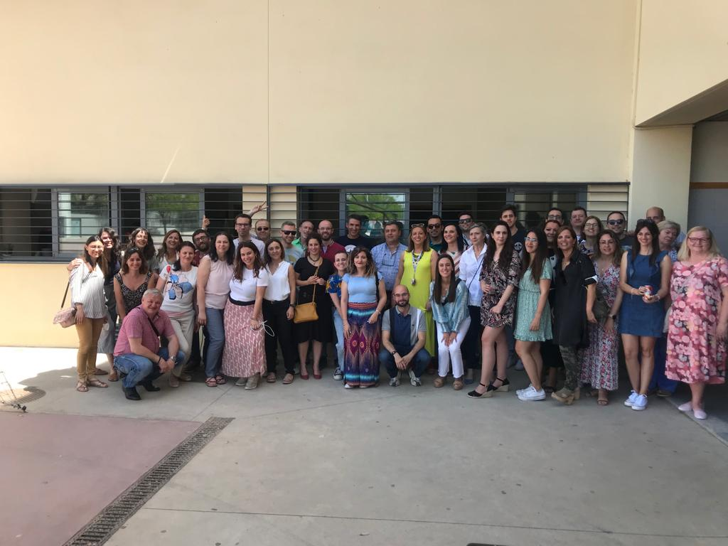
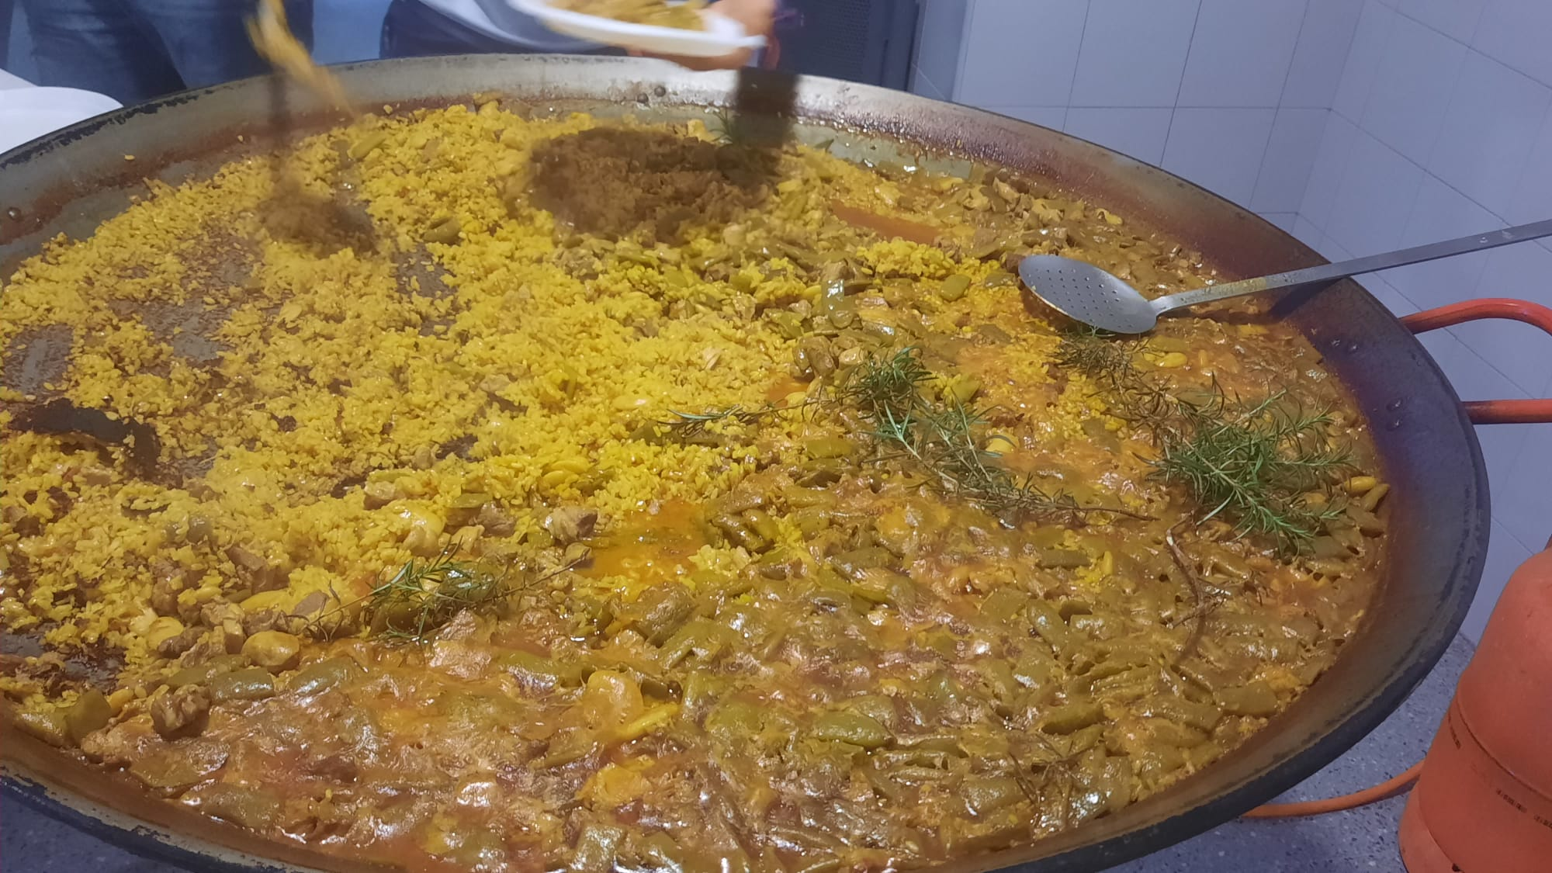
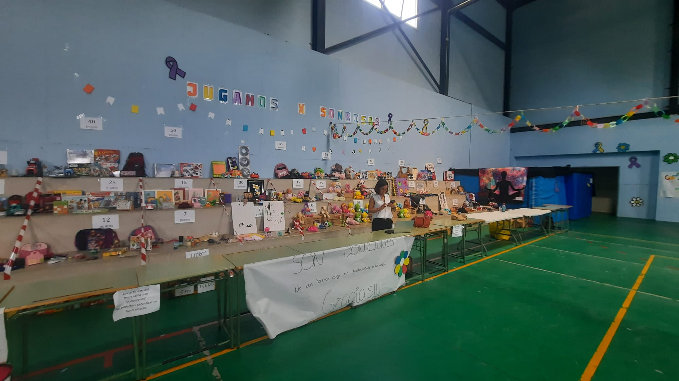
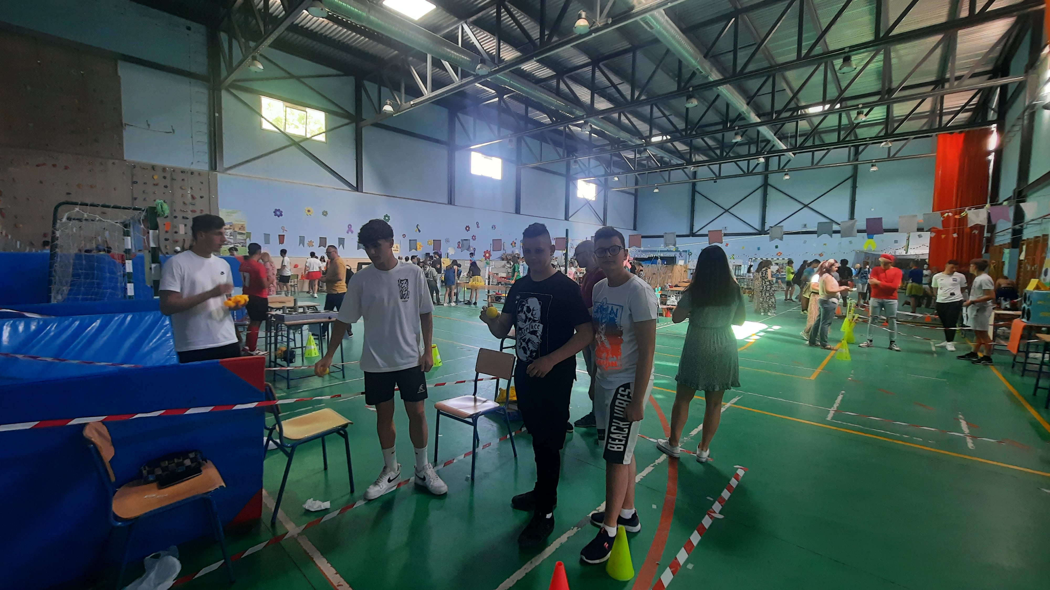
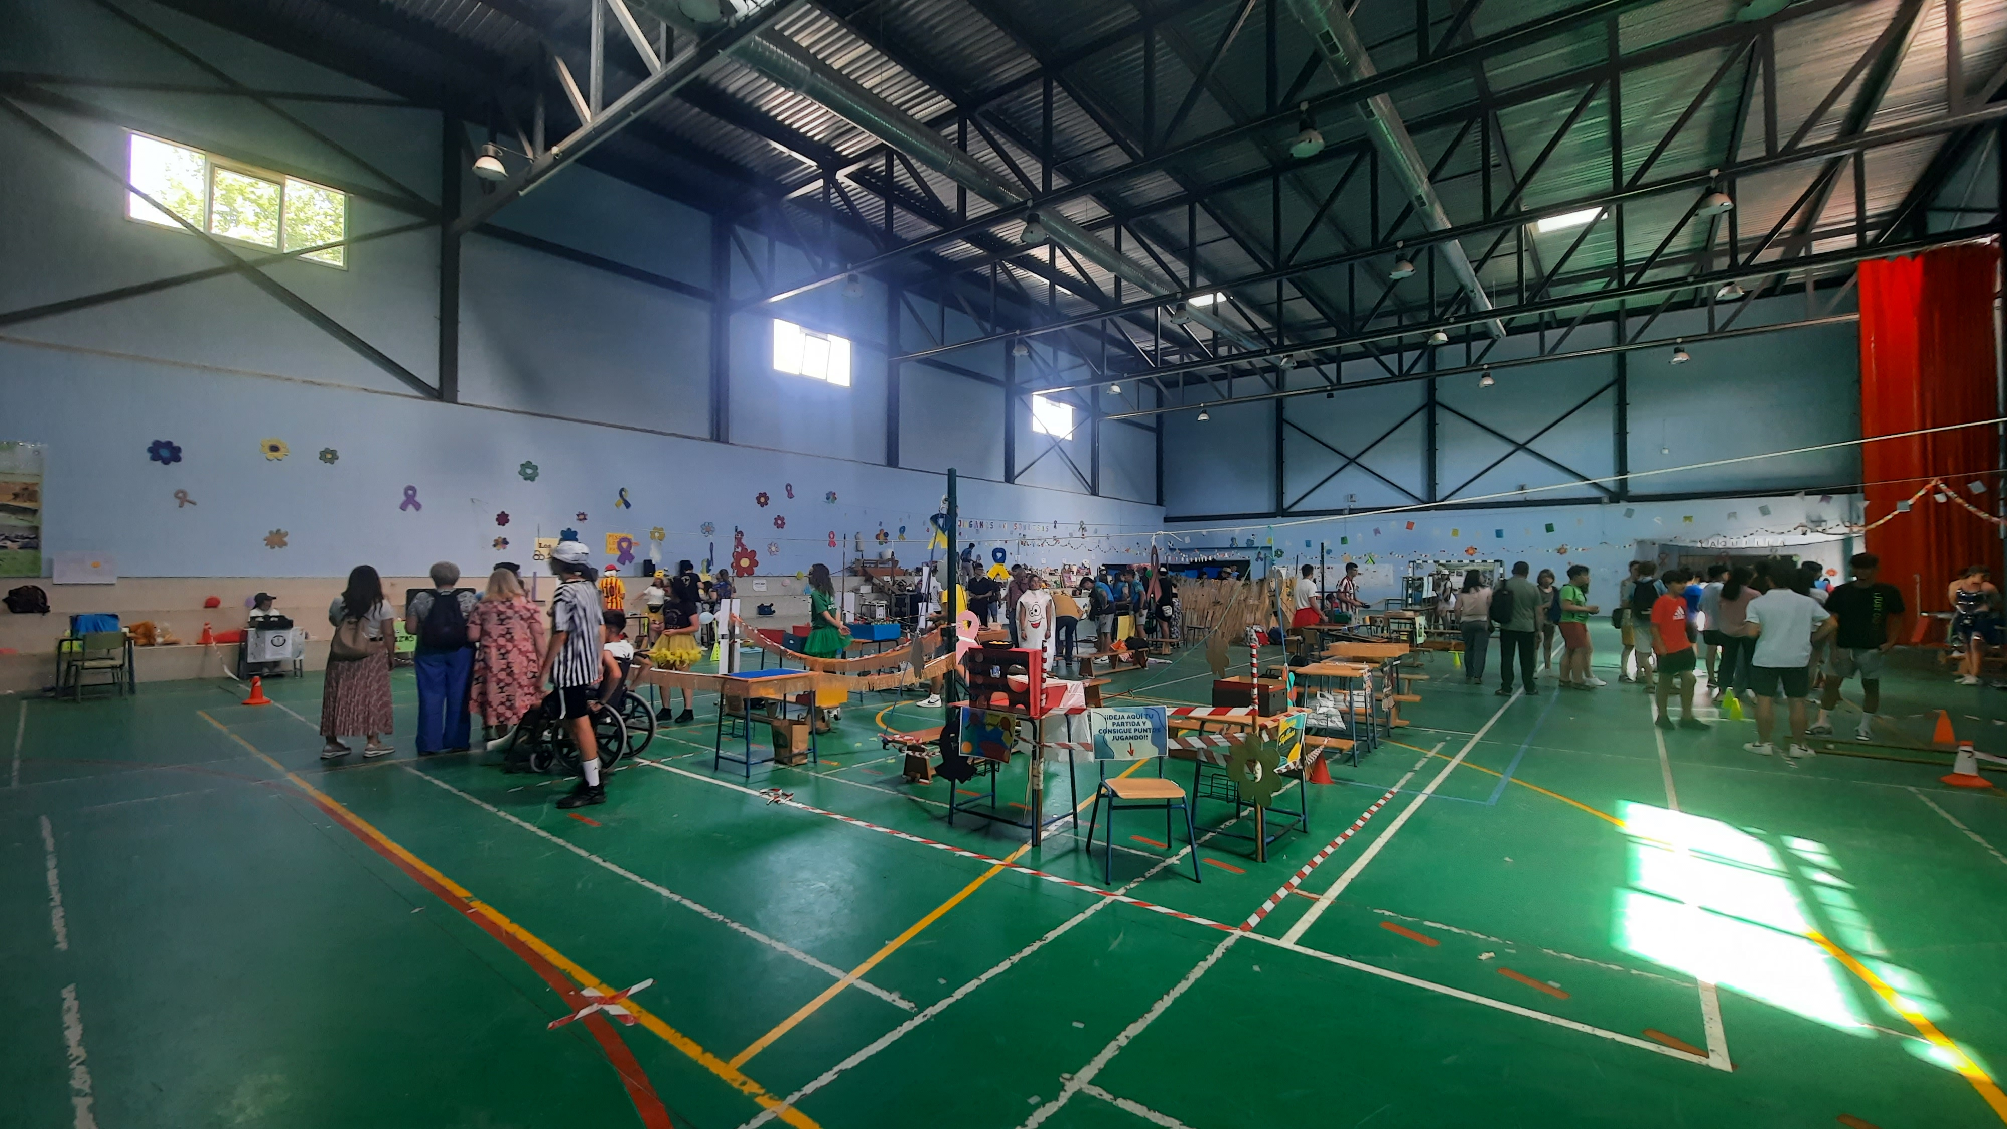

Slide 5
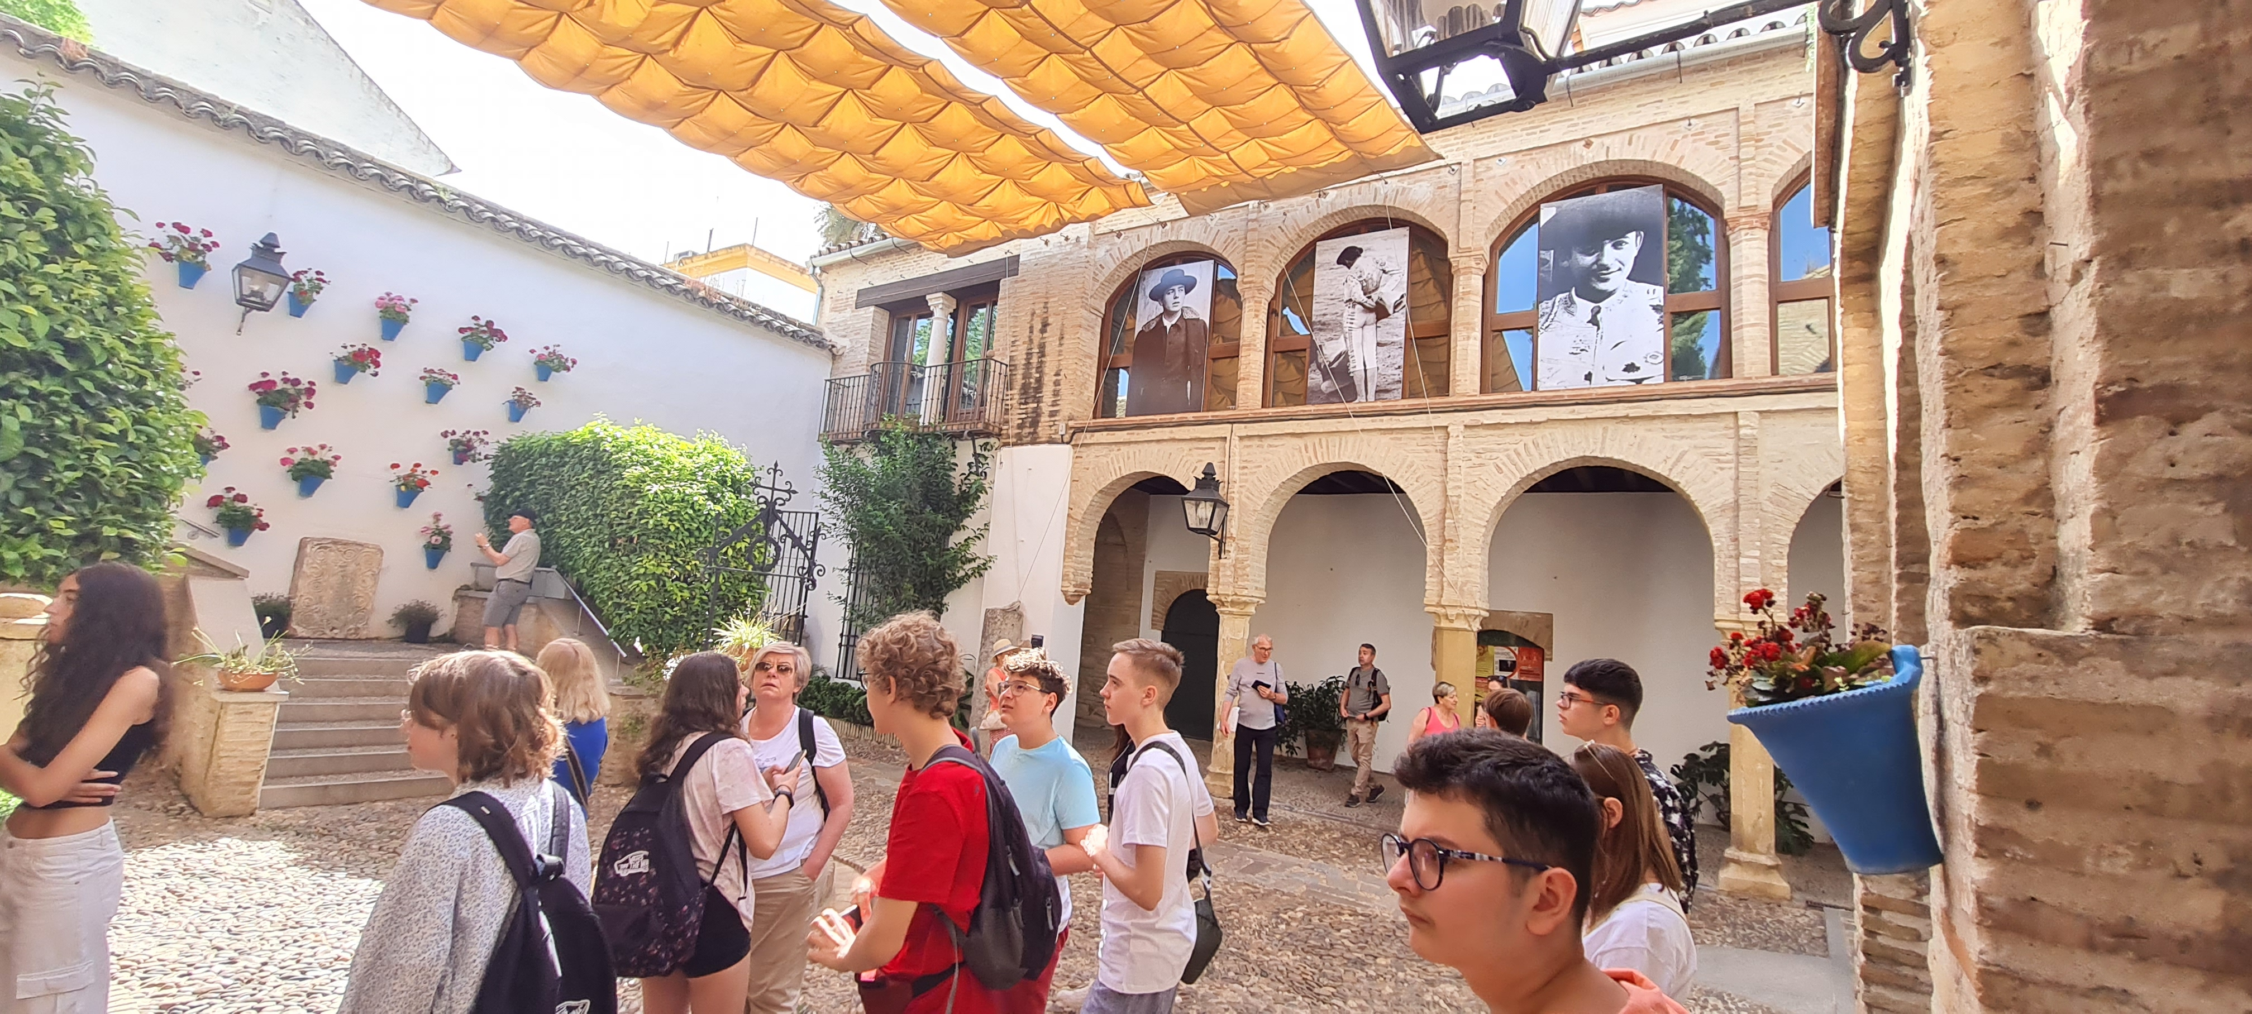
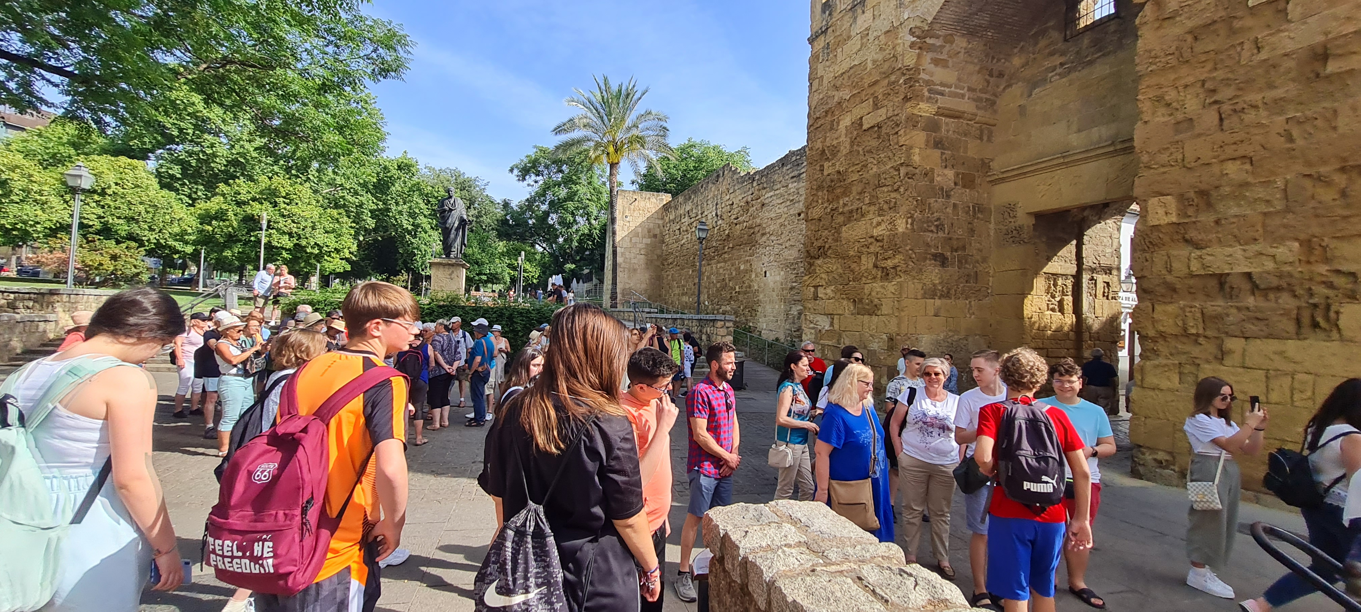
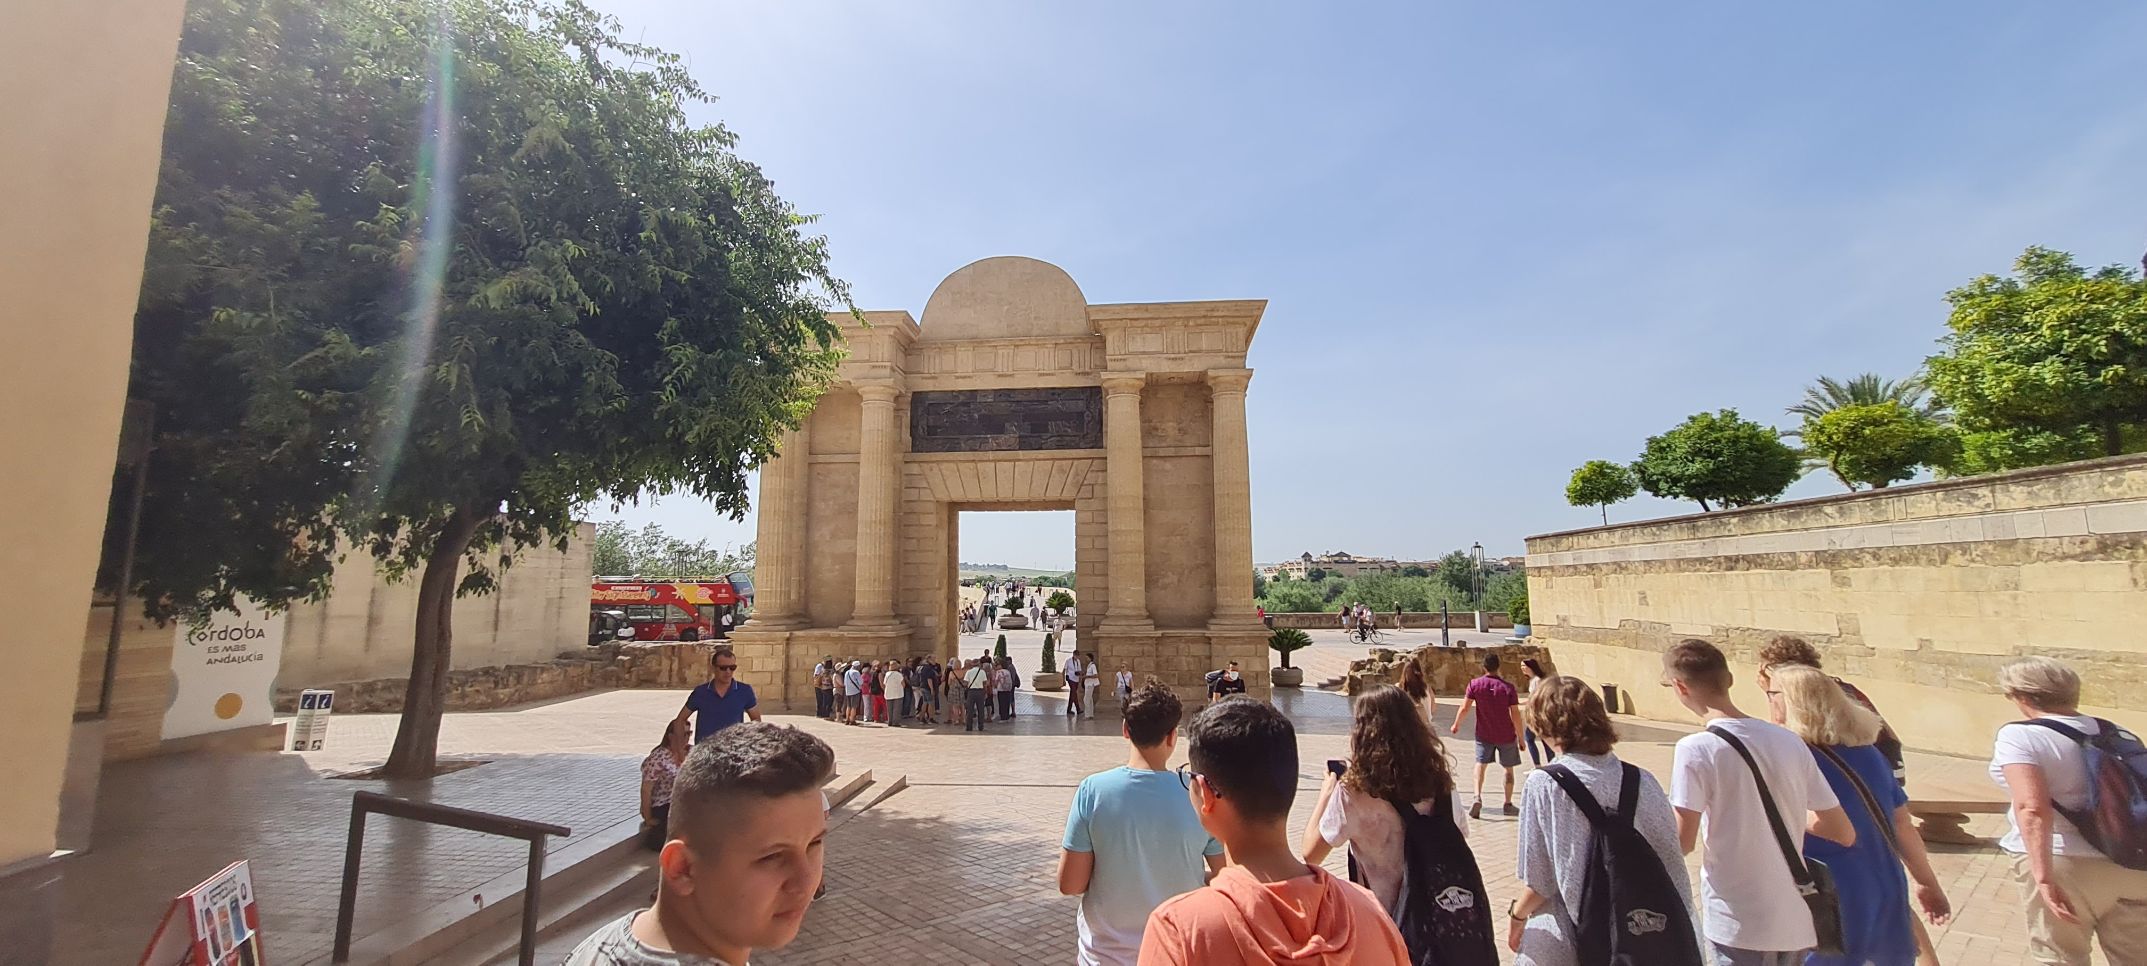
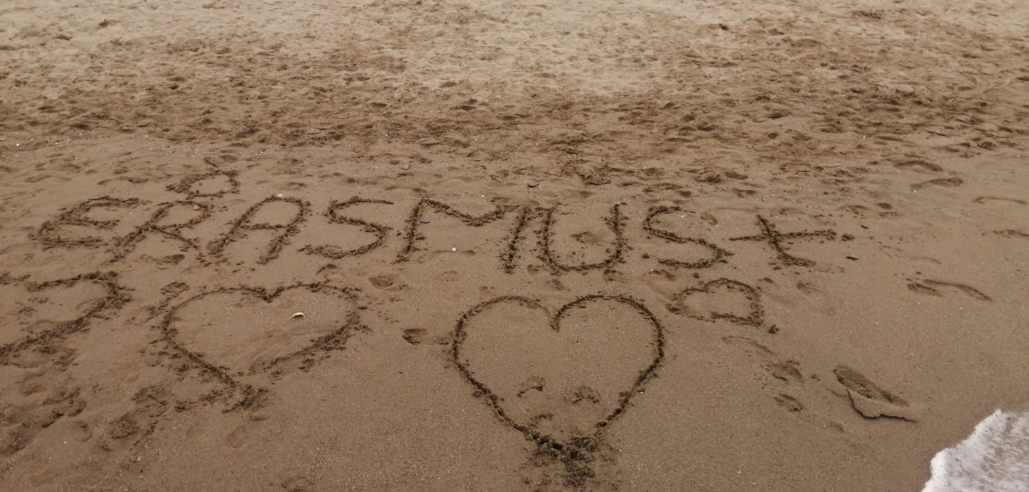
The thematic visits to Baena, Cabra, Cordoba and Malaga favored intercultural dialogue and enriched students' knowledge of Spanish culture and traditions.

Slide 6
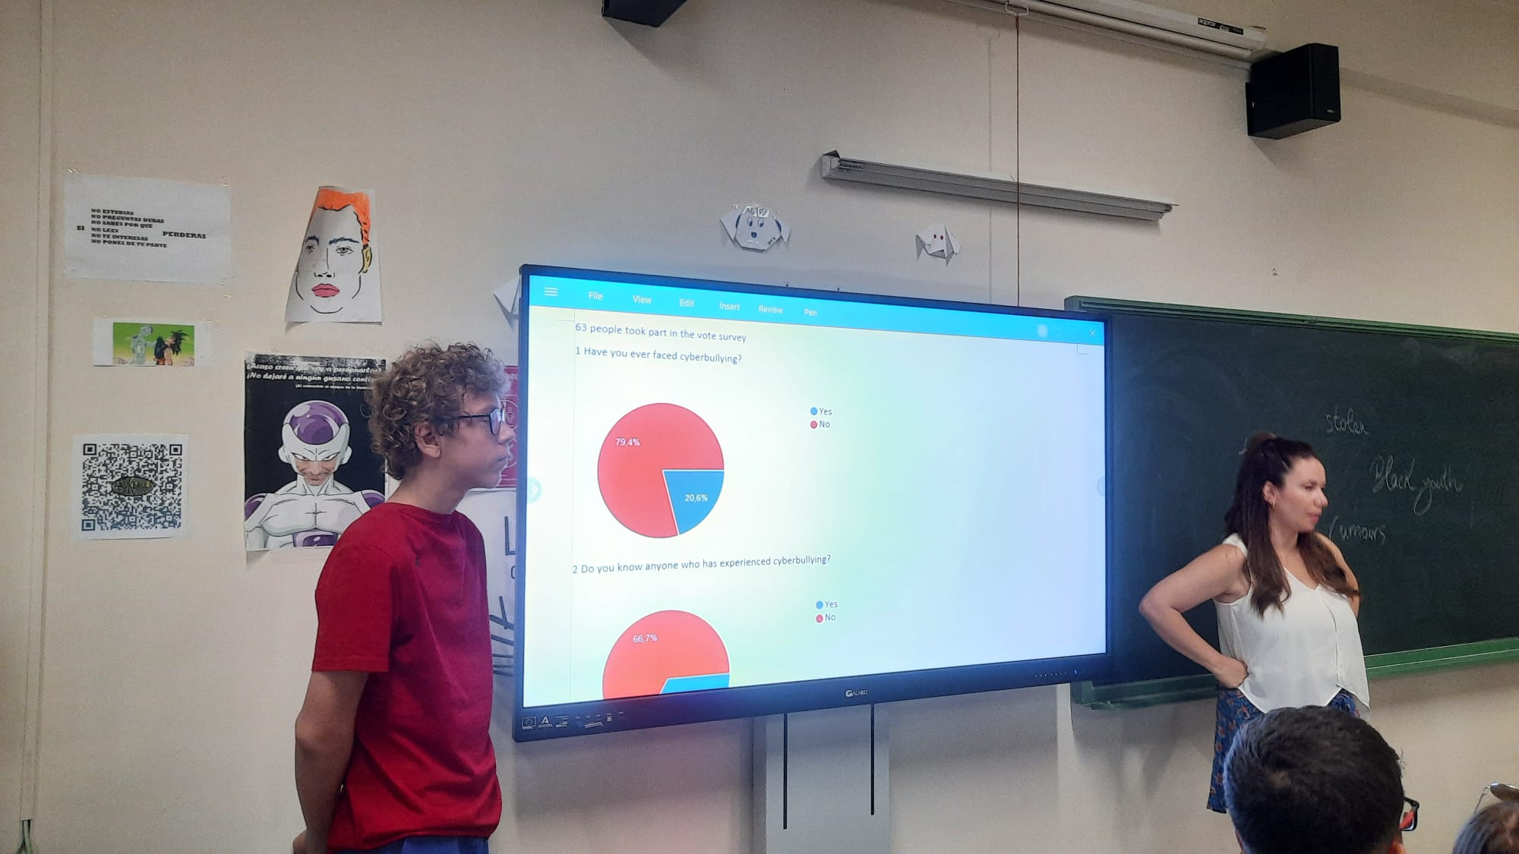
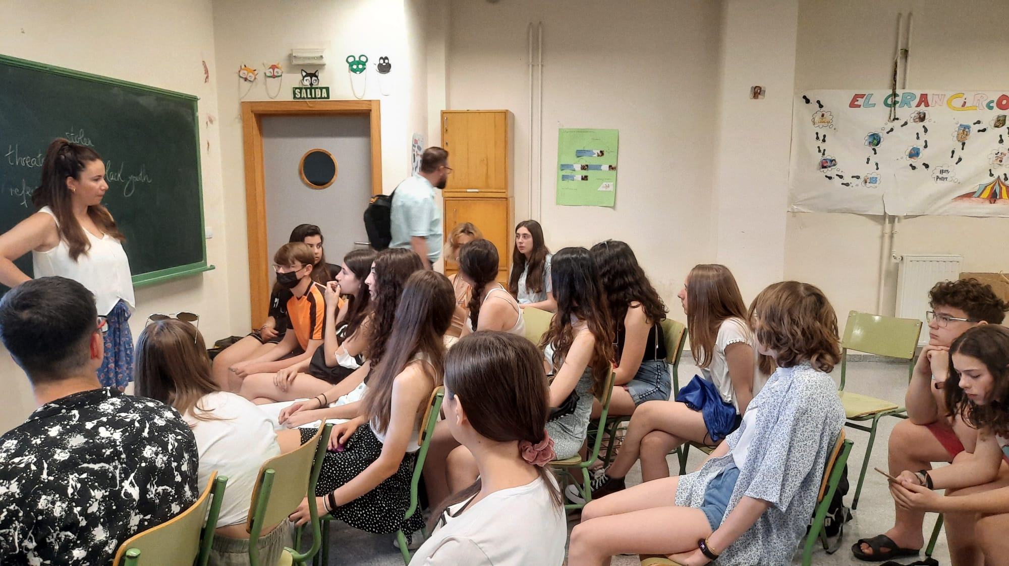
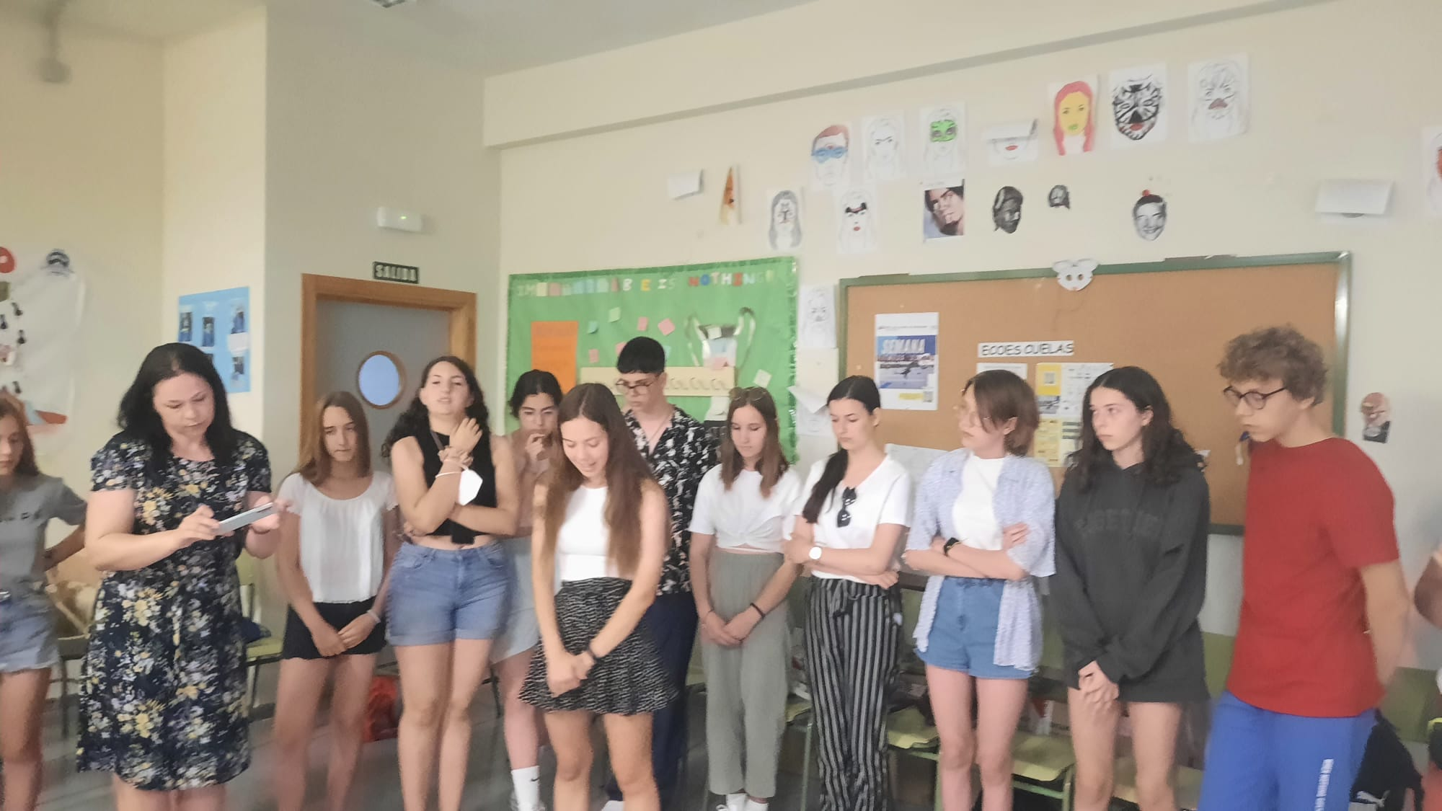
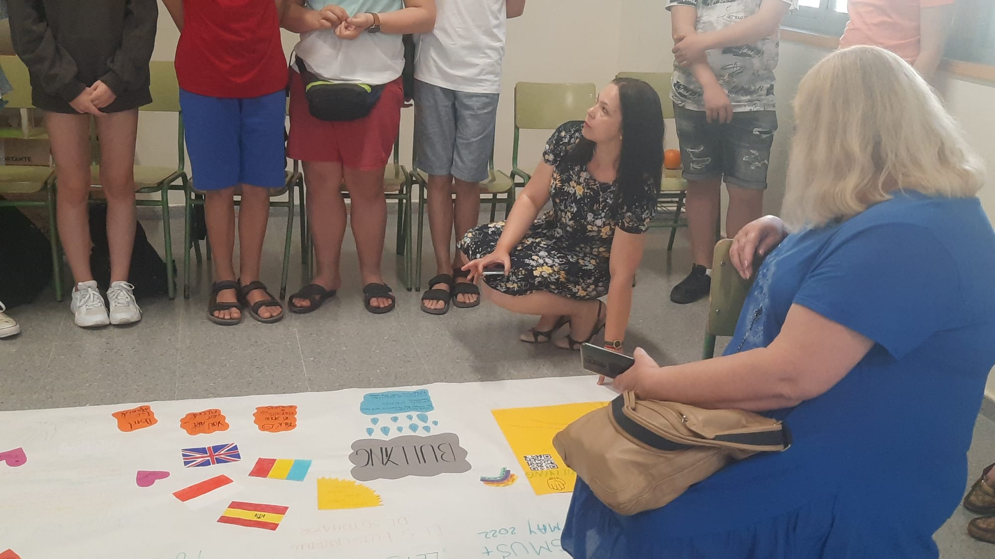
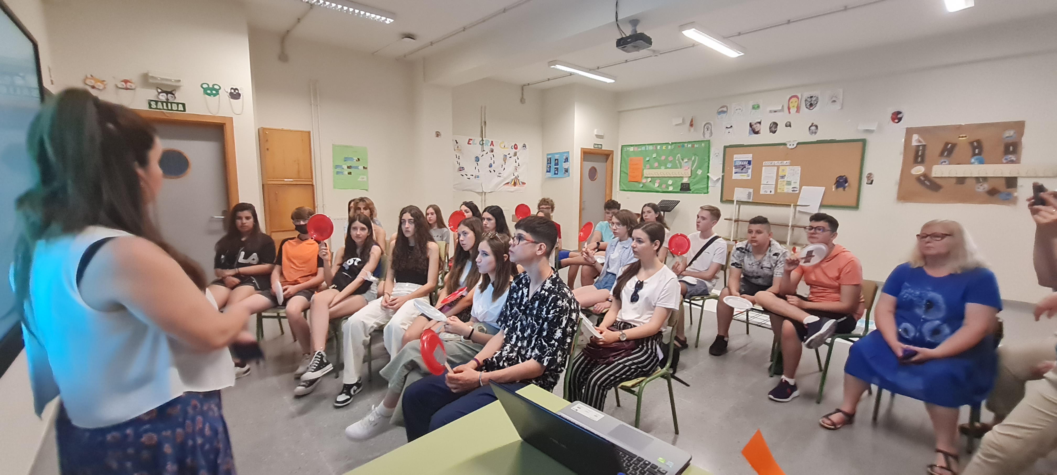

Slide 7
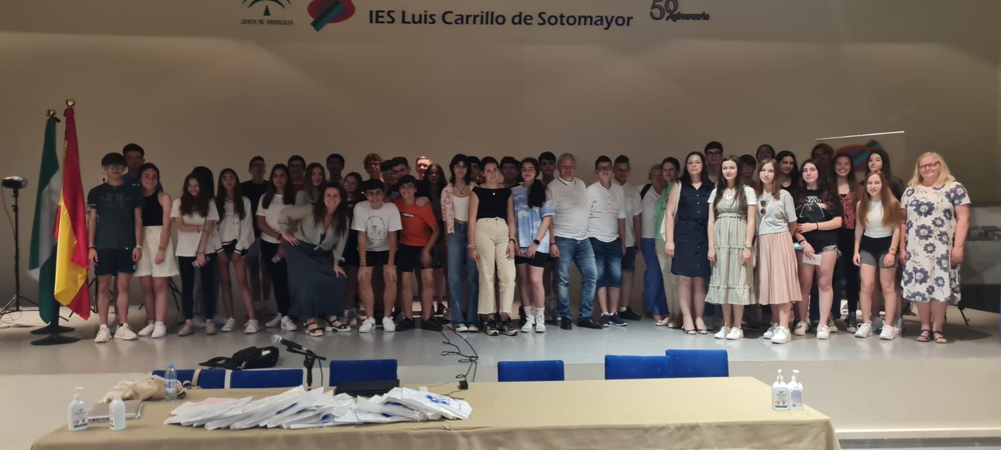
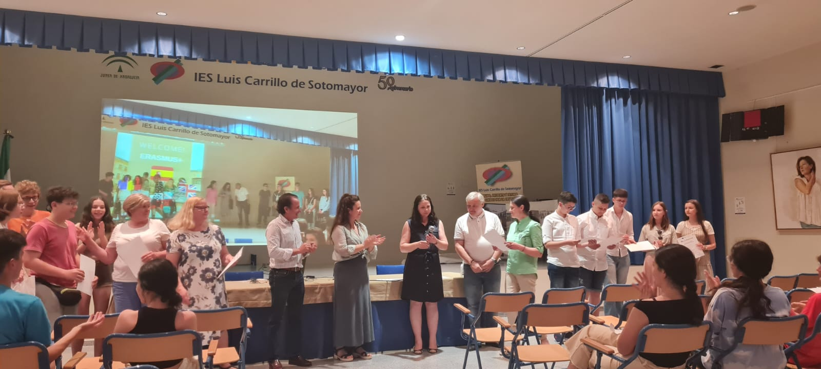
The meeting of the project ended in a festive setting by handing out certificates of participation in activities.

